Slide 1
Data Science and Machine Learning
Module One: Introduction to R Programming
Trainer: Dr Ayman Rawshdeh

Slide 2






Data Science and Machine Learning with R
Module 1— Introduction to R Programming

Slide 3

Learning Objectives
Outline the importance of R and its significance on data analytics
Explain data types and variables in R
Discuss the types of R operators
Describe different types of conditional statements in R
Examine different types of loops in R
Analyze methods to run an R script
List commonly used R functions

Slide 4
Introduction to R Programming
Topic 1—Importance of R

Slide 5

The Big Supermarket War
The UK's big four supermarkets have been engaged in a price war as German discounters expand rapidly in the UK.
One of the leading supermarkets in United Kingdom, Sainsbury’s, was facing a business problem with declining sales during early 2016. The company had two straight years of profit decline, and its share value had fallen by 7% over the past month.

Slide 6

The Comeback
In a few months, Sainsbury’s was able to regain its hold in the market and be the biggest riser of Financial Times Stock Exchange 100 index.
How did the supermarket achieve this?

Slide 7

The Comeback
Along with its many other strategies, Sainsbury’s deployed R software to its system.

Slide 8

How R Is Implemented at Sainsbury’s
The retail store’s daily sales are updated and refreshed every 30 minutes from local retail store machines to big data server. R system is connected to the big data server to analyze the real-time data.
Plan

Slide 9

How R Is Implemented at Sainsbury’s
Plan
Models and codes are built up in R to trace any decline in sales as per the forecasting model prediction.

Slide 10

How R Is Implemented at Sainsbury’s
Plan
Live R system will throw alerts if the sales go below the bottom cut-off limit defined in the time series forecasting model.

Slide 11

How R Is Implemented at Sainsbury’s
Apriori algorithm is used to give offers on associated products, and time series forecasting modeling technique is deployed to trigger any decline in sales.
Plan
Reference

Slide 12
What Is R?
R is a free, open-source language used as a statistical and visualization software. It can handle structured as well as semi-structured data.

Slide 13

Features of R
Is available across all platforms, such as Linux, Mac, and Windows
Has the ability to integrate with the procedures written in the C, C++, .Net, Python, SAS, SPSS, or FORTRAN languages
Has an effective data handling and storage facility
Has a programming logic similar to Python and MATLAB
Provides a wide variety of integrated collection of tools for data analytics
R has a worldwide repository system – CRAN. The Comprehensive R Archive Network (CRAN) is a network of sites that acts as the primary web service distributing R sources and binaries, extension packages, and documentation.

Slide 14
Why R for Data Analytics?
And … R is a free software.

Slide 15
Why R for Data Analytics?
R is a statistical software where complex stats models like linear regression, logistic regression, hypothesis testing, ANOVA(Analysis Of Variance), GLM(Generalized Linear Model), etc., can be run.

Slide 16
Why R for Data Analytics?
R has some great tools to aid data visualization to create graphs, bar charts, multi-panel lattice charts, scatter plots, and new custom-designed graphics.

Slide 17
Why R for Data Analytics?
ML algorithms like SVM, Naives Bayes theorem, XGboost, Decision tree, and Random forest are available in R readily. These algorithms have proven to be better over time and provide good accuracy of results.

Slide 18
Why R for Data Analytics?
You can now write R codes in SAS as R codes are widely used, and programmers are getting familiar with these.
R can handle semi-structured data and has algorithms built.

Slide 19
Why R for Data Analytics?
Programmers can define their customized algorithms in R and develop their own algorithms and packages.

Slide 20
Introduction to R Programming
Topic 2—Data Types and variables in R

Slide 21
Example – Data Types And Variables
Consider the code given below:
int a=5
Data type
Value
Variable

Slide 22
Data Types in R
Data Type | Description | Example
Logical | Boolean values | TRUE, FALSE
Numeric | Numbers of all kinds | 6, 18.5, 825
Integer | Explicit Integers | 8L, 45L
Complex | Real Value + Complex Value | 7+5i
Character | Characters and Strings | ‘g’ “Smith”
Raw | Any data is stored as raw bytes | “Hello” is stored as 68 65 6c 6c 6f

Slide 23
Variables in R
Variables are logical names for pieces of data. They are used to store data, and their value can be changed.
The unique name given to a variable is called an identifier.
Rules for defining variable names are as follows:
Variable names can consist of a combination of letters, numbers, underscore, and period.
It should begin with a letter or a period. If it starts with a period, then it cannot be followed by a digit.
Reserved words in R cannot be used as identifiers.

Slide 24
Introduction to R Programming
Topic 3—Operations in R

Slide 25
Operators in R
R has many operators to perform different mathematical and logical operations.
Arithmetic Operators
Relational
Operators
R Operators
Assignment
Operators
Logical Operators

Slide 26
Operators in R
Arithmetic Operators
Relational Operators
Logical Operators
Assignment Operators
These operators are used for mathematical operations like addition and multiplication.
Operator | Description
+ | Addition
- | Subtraction
* | Multiplication
/ | Division
^ | Exponent
%% | Modulus
%/% | Integer Division
%*% | Matrix Multiplication

Slide 27
Operators in R
EXAMPLE
Arithmetic Operators
Relational Operators
Logical Operators
Assignment Operators
x=10 ; y =3
Operator | Code | Output
+ | x+y | 13
- | x-y | 7
* | x*y | 30
/ | x/y | 3.333
^ | x^y | 1000
%% | x%%y | 1
%/% | x%/%y | 3

Slide 28
Operators in R
Arithmetic Operators
Relational Operators
Logical Operators
Assignment Operators
These operators are used to compare two values. The result is a logical vector.
Operator | Description
< | Less than
> | Greater than
<= | Less than or equal to
>= | Greater than or equal to
== | Equal to
!= | Not equal to
While single = assigns value, double == checks if the value of element in an R object is equal to defined
value.

Slide 29
Operators in R
EXAMPLE
Arithmetic Operators
Relational Operators
Logical Operators
Assignment Operators
Operator | Code | Output
< | 2<3 | TRUE
> | 2>3 | FALSE
<= | 2<=2 | TRUE
>= | 3>=3 | TRUE
== | x = 3^4, x==81 | TRUE
 | x = 3^4, x==80 | FALSE
!= | 2!=3 | TRUE

Slide 30
Operators in R
Arithmetic Operators
Relational Operators
Logical Operators
Assignment Operators
These operators are used to perform Boolean operations such as “AND” and “OR.”
Operator | Description
! | Logical NOT
& | Element-wise logical AND
&& | Logical AND
| | Element-wise logical OR
|| | Logical OR

Slide 31
Operators in R
EXAMPLE
Arithmetic Operators
Relational Operators
Logical Operators
Assignment Operators
x=1 ; y=2
Operator | Code | Output
! | x!=10 | TRUE
& | x==1 & y==2 | TRUE
&& | x<1 && y>4 | FALSE
| | x==1 | y==3 | TRUE
|| | x=2 || y=2 | TRUE

Slide 32
Operators in R
Arithmetic Operators
Relational Operators
Logical Operators
Assignment Operators
These operators are used to assign values to variables.
Variables are assigned using “<-”, although “=” also works.
Example:
age <- 18 (left assignment ) 18 -> age (right assignment)

Slide 33
Introduction to R Programming
Topic 4—Conditional Statement in R

Slide 34
Conditional Statements in R
Conditional statements are used to check if certain conditions are met.
R supports two types of conditional statements:
If…else
Other forms of if..else are ifelse function and switch statement
Nested if…else

Slide 35
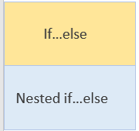
Types of Conditional Statements
When the test expression is true, the code in the “if” block executes; otherwise, the
code in the “else” block executes.
Example:
age <- 20
if(age > 18){ print("Major")
} else {
print(“Minor”)
}
Output:
[1] "Major"

Slide 36
Types of Conditional Statements
If…else
This is a vector equivalent form of if…else.
Ifelse() function
Example:
age <- 20 Ifelse(age>=18, “Major”,”Minor”)
Switch statement
Nested if…else
Output:
[1] "Major"

Slide 37
Types of Conditional Statements
If…else
Switch is a control statement that allows a value to change control of execution.
It is similar to a controlled branch of if…else statement.
Ifelse() function
Example:
age <- "Major" switch(age, Major={
print("Age is greater than 18")
},
Minor={
print("Age is
less than 18")
}
)
Switch statement
Nested if…else
Output:
[1] "Age is greater than 18"

Slide 38
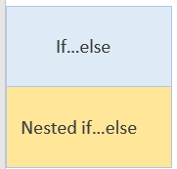
Types of Conditional Statements
In nested if...else statements, only one statement executes, depending on the test expressions in
the ‘if’ blocks.
Example:
x <- 0
if (x < 0) {
print("Negative
number")
} else if (x > 0)
{
print("Positive number")
} else
print("Zero")
Output:
[1] "Zero"

Slide 39
Introduction to R Programming
Topic 5—Loops in R

Slide 40
Loop Statement
A loop is a control flow statement that executes a statement or a group of statements many times.

Slide 41
Types of Loops
For Loop
While Loop
Repeat Loop
The for loop executes a code a specific number of times.
Example:
vec <- c(1,2,3,4,5) for (val in vec) { print(val)
}
 |  | [1] | 1
 |  | [1] | 2
 |  | [1] | 3
 |  | [1] | 4
 |  | [1] | 5
Output:

Slide 42
Types of Loops
For Loop
While Loop
Repeat Loop
In the while loop, while the test expression remains true, the code inside the loop keeps on executing.
Example:
i <- 1 while (i < 6) { print(i) i = i+1
 | }
 |  | [1] | 1
 |  | [1] | 2
 |  | [1] | 3
 |  | [1] | 4
 |  | [1] | 5
Output:

Slide 43
Types of Loops
For Loop
While Loop
Repeat Loop
A repeat loop iterates a code multiple times.
Since there is no conditional check to exit the loop, you must specify it inside the body of the loop.
Example:
x <- 1
repeat
{
print(x) x = x+1
if (x == 6){ break
}
}
Output:
[1] | 1
[1] | 2
[1] | 3
[1] | 4
[1] | 5

Slide 44
Loop Control Statements
Loop control statements exit the loop without executing all the statements.
Loop control statements used in R:
Break statement
Next statement

Slide 45
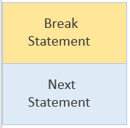
Loop Control Statements
When present inside a loop, it stops the iterations from executing and forces the flow to exit the
loop.
Example:
num <- 1:5
for (val in num)
{
if (val == 3)
{
break
}
print(val)
}
Output:
[1] 1
[1] 2

Slide 46
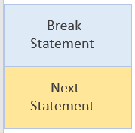
Loop Control Statements
It helps in skipping the current iteration of a loop.
Example:
num <- 1:5
for (val in num)
{
if (val == 3)
{
next
}
print(val)
}
Output:
[1] 1
[1] 2
[1] 4
[1] 5

Slide 47
More Efficient Alternatives to Loops in R
The apply() collection, listed below, are primarily to avoid expensive uses of loop constructs.
Function | Code
apply() | Apply a function to the rows or columns of a matrix or data frame. Returns the result in the form of a vector or array or list of values obtained
lapply() | Apply a function to vector, data frame, and list of objects. Returns a list of objects of the same length
sapply() | Apply a function to vector, data frame, and list of objects. Returns an array or matrix of the same length
tapply() | Apply a function or operation on subset of the vector broken down by a given factor variable.

Slide 48
Introduction to R Programming
Topic 6—R Script

Slide 49
R Script
R script is a text file that contains a set of commands to be executed in R.

Slide 50
Features of R Script
The commands are executed in the console.
Script files allow you to execute long and multiple commands easily at once.
The file is saved with an extension “.R”

Slide 51
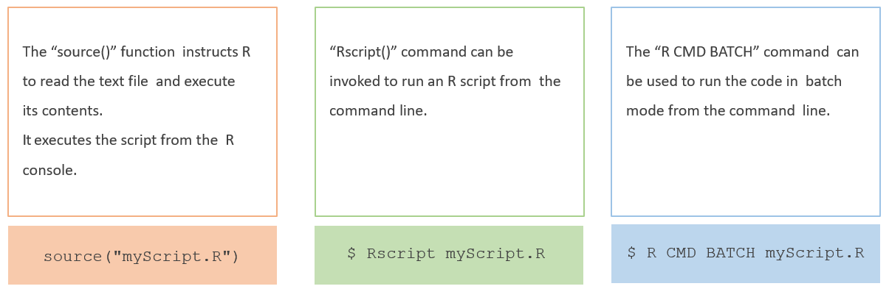
Methods to Run an R Script
R script can be run by any of the following methods:

Slide 52
Introduction to R Programming
Topic 7—Functions in R

Slide 53
R Functions
A function is a code used to execute a specific task.

Slide 54
Some Aspects of R Functions
Functions are stored as R objects.
There are over 1000 functions at the core of R, and new R functions are created all the time.
Each R function comes with its own help page. To access a function’s help page, type a question mark followed by the function’s name in the console.

Slide 55
R Functions
Function | Description
append() | Add elements to a vector
c() | Combine values into a vector or list
identical() | Test if two objects are exactly equal
length() | Return the length of the R object
ls() | List objects in the current environment
range(x) | Return the minimum and maximum of the vector
rep(x,n) | Repeat the number x, n times
rev(x) | Provide the reversed version of an argument
seq(x,y,n) | Generate regular sequences from x to y, spaced by n
unique(x) | Remove duplicate entries from the vector

Slide 56
R Functions
Function | Description
tolower() | Convert a string to lower case letters
toupper() | Convert a string to upper case letters
grep() | Use for regular expressions
summary(x) | Return object summaries
str(x) | Compactly display the structure of an arbitrary R object
glimpse(x) | Compactly display the structure of an arbitrary R object (dplyr package)
class(x) | Return the class of an object
mode(x) | Get or set the type or storage mode of an object
summary(x) | Return object summaries
tolower() | Convert a string to lower case letters

Slide 57


Key Takeaways
R is a free, open-source programming language that is most useful for statistical
computation and visualization.
There are six data types in R: logical, numeric, integer, complex, character, and raw.
Variables are used to store data, and the unique name given to it is called identifier.
There are four types of operators in R: arithmetic, relational, logical, and assignment.
Conditional statements are used to verify if the required conditions are met.
The two conditional statements used in R are if…else and nested if…else.
A loop is a control flow statement that executes a statement or a group of statements many times. The loop statements used in R are for loop, while loop, and repeat loop.
R script is a text file that contains a set of commands to be executed in R.
A function is a code used to execute a specific task, and there are over 1000 functions available in R.

Slide 58
This concludes “Introduction to R Programming.”

